Slide 1
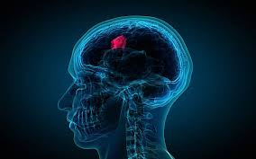
TUMOR IDENTIFICATION
Presented by: Group 3 (CSE 3B)

Slide 2
GROUP MEMBERS
TEAM MEMBER NAME | TEAM MEMBER ROLL NUMBER
MINHAJ UDDIN | 1721610064
SHIVAM AGRAWAL | 1721610100
SHIVAM ROY | 1721610101
RISHI KUSHWAHA | 1721610088
SYED. MOHD. AFZAL | 1721610116
VIJAY KUMAR SINGH | 1721610124
PRATEEK CHORASIYA | 1721610074

Slide 3
INTRODUCTION
WHAT IS A TUMOR ?
WHY WE USE AN AI BASED MODEL
TO RECTIFY THE CAUSE ?

Slide 4
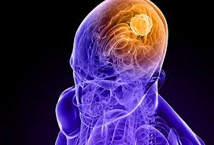
TUMOR
A BRAIN TUMOR IS A COLLECTION OF ABNORMAL CELL IN BRAIN.
OUR BRAIN IS A MOST CRITICAL AND COMPLEX PART OF OUR BODY AND ANY KIND OF UNWANTED ABNORMALITY CAN CAUSE SERIOUS INJURIES .
SO WE MUST HAVE TO DIAGNOSE AND TREAT THEV CAUSE AS EARLY AS POSSIBLE.

Slide 5
WHY WE USE AN AI BASED MODEL?
PERFORM OVER LARGE DATA
HIGHER ACCURACY
MORE CONVENIENT
USE LESS TIME
SAVES MONEY

Slide 6
VARIOUS STEPS INVOLVED
IMPORTING LIBRARIES
COLLECTING DATABASE
ANALYSIS DATABASE
DEFINE MODEL DESCRIPTION
TRAINING THE MODEL AND PLOT LOSS AND ACCURACY CURVE
TESTING THE MODEL
RESULT

Slide 7
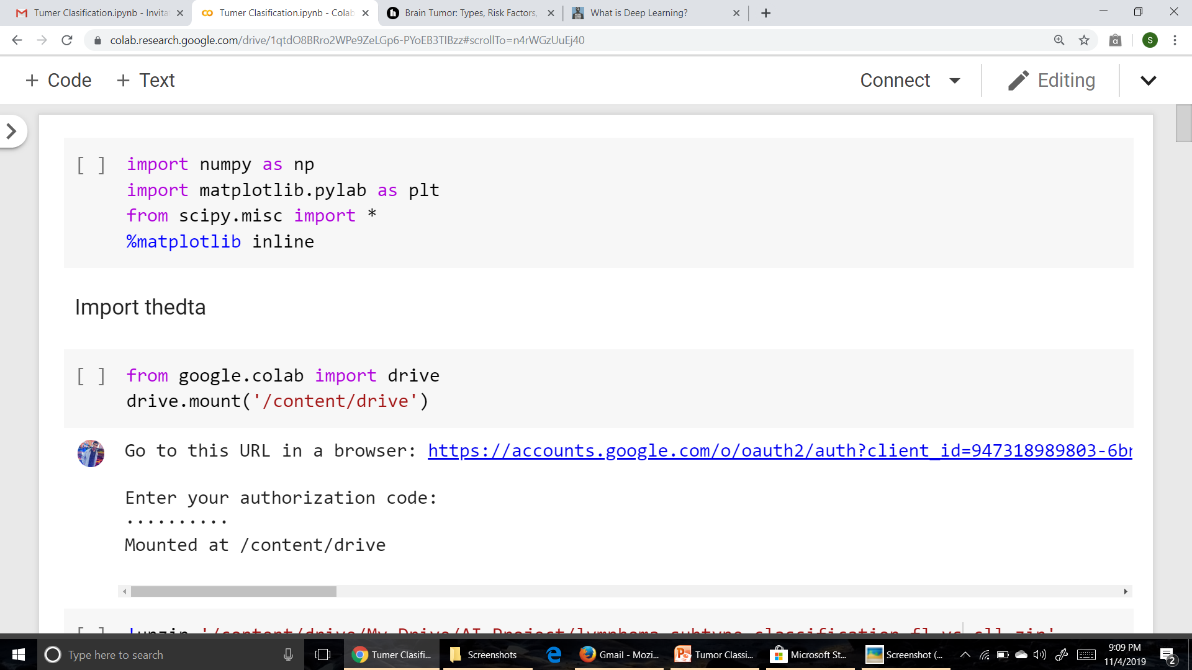
IMPORTING THE REQUIRED LIBRARIES

Slide 8
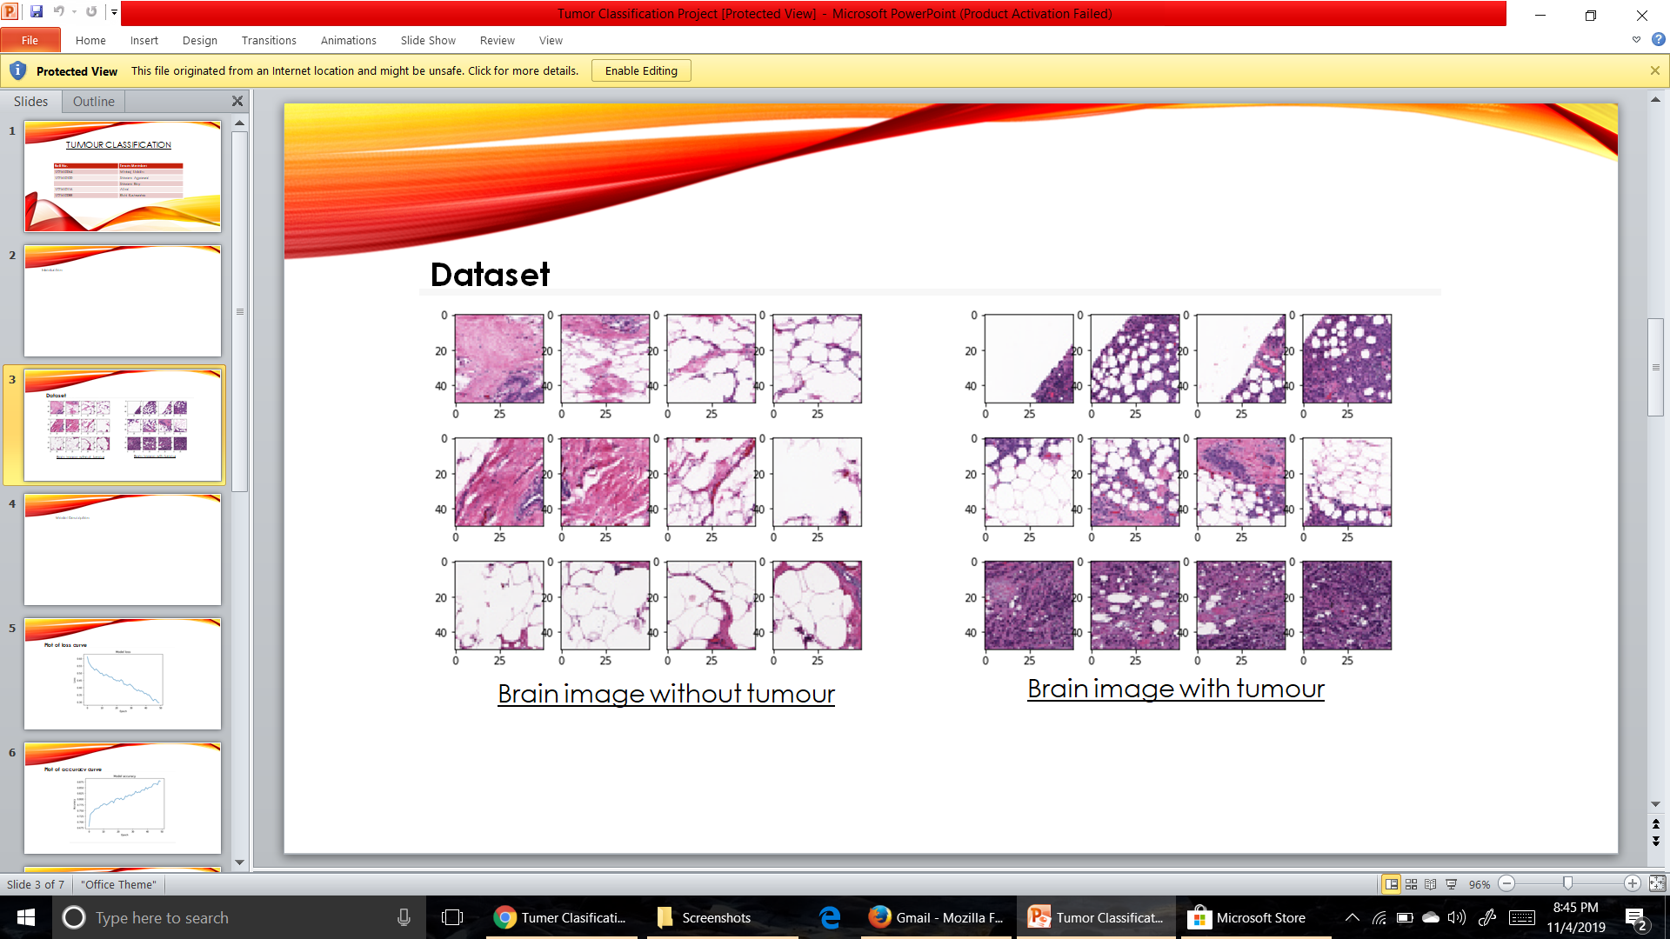
COLLECTING THE DATABASE

Slide 9
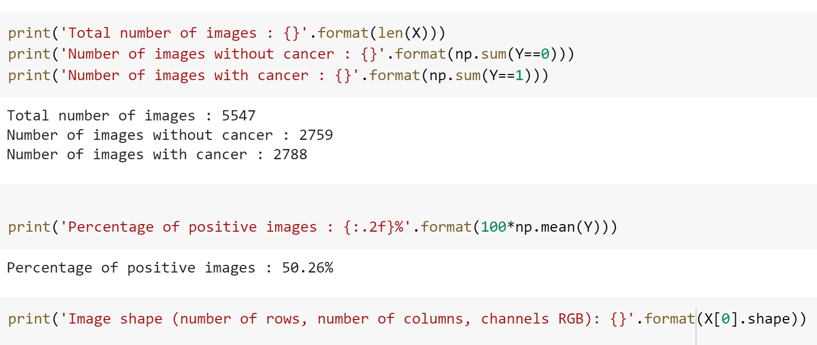
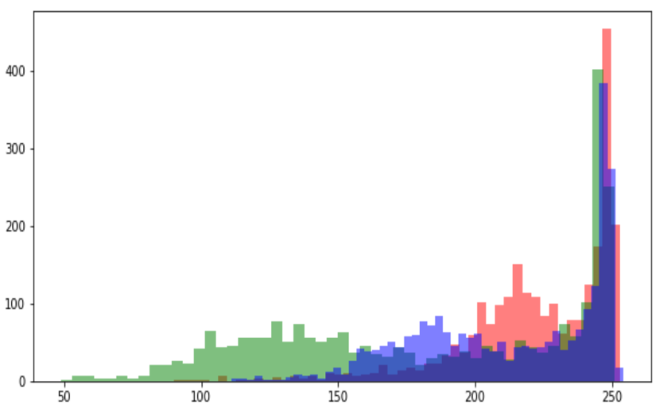
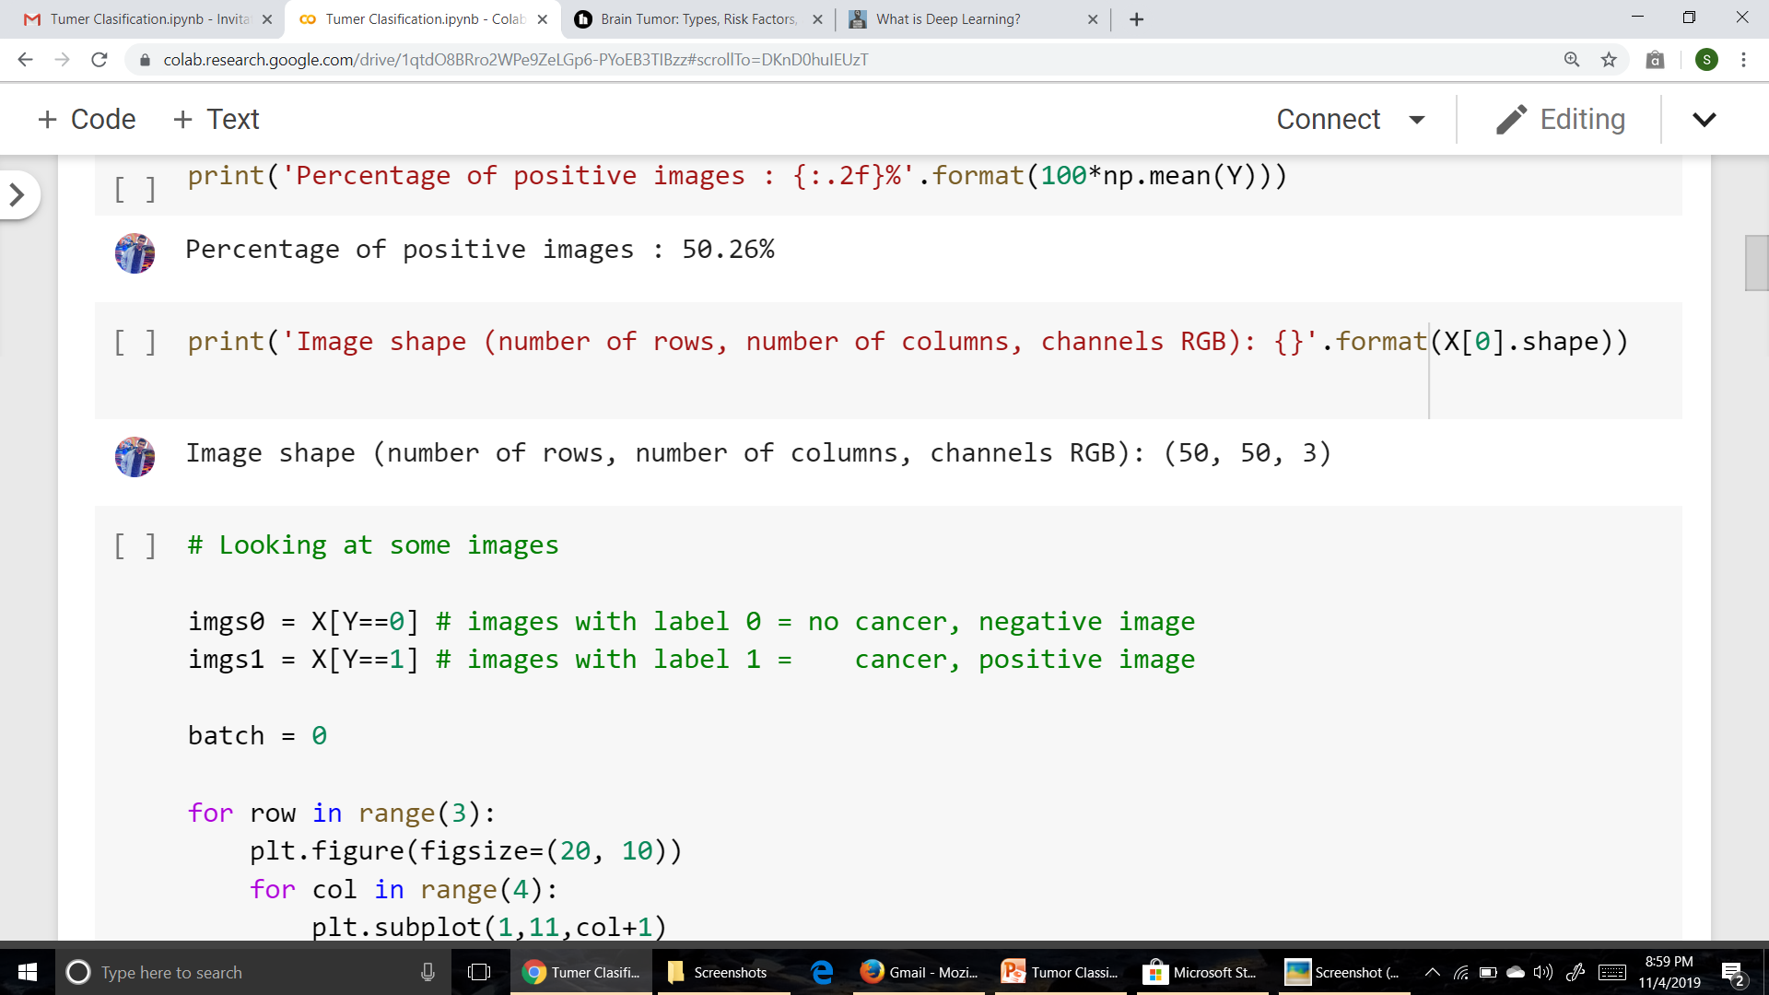
ANALYSIS OF DATABASE

Slide 10
MODEL DESCRIPTION
SUPERVISED MODEL
BASED ON DEEP LEARNING
MODEL IS BASED ON CONVOLUTION NEURAL NETWORK(CNN) ARCHITECTURE
CLASSIFICATION(DISCRETE) TYPE MODEL
ACTIVATION FUNCTIONS USE: RELU & SIGMOID
SEQUENCIAL MODEL

Slide 11
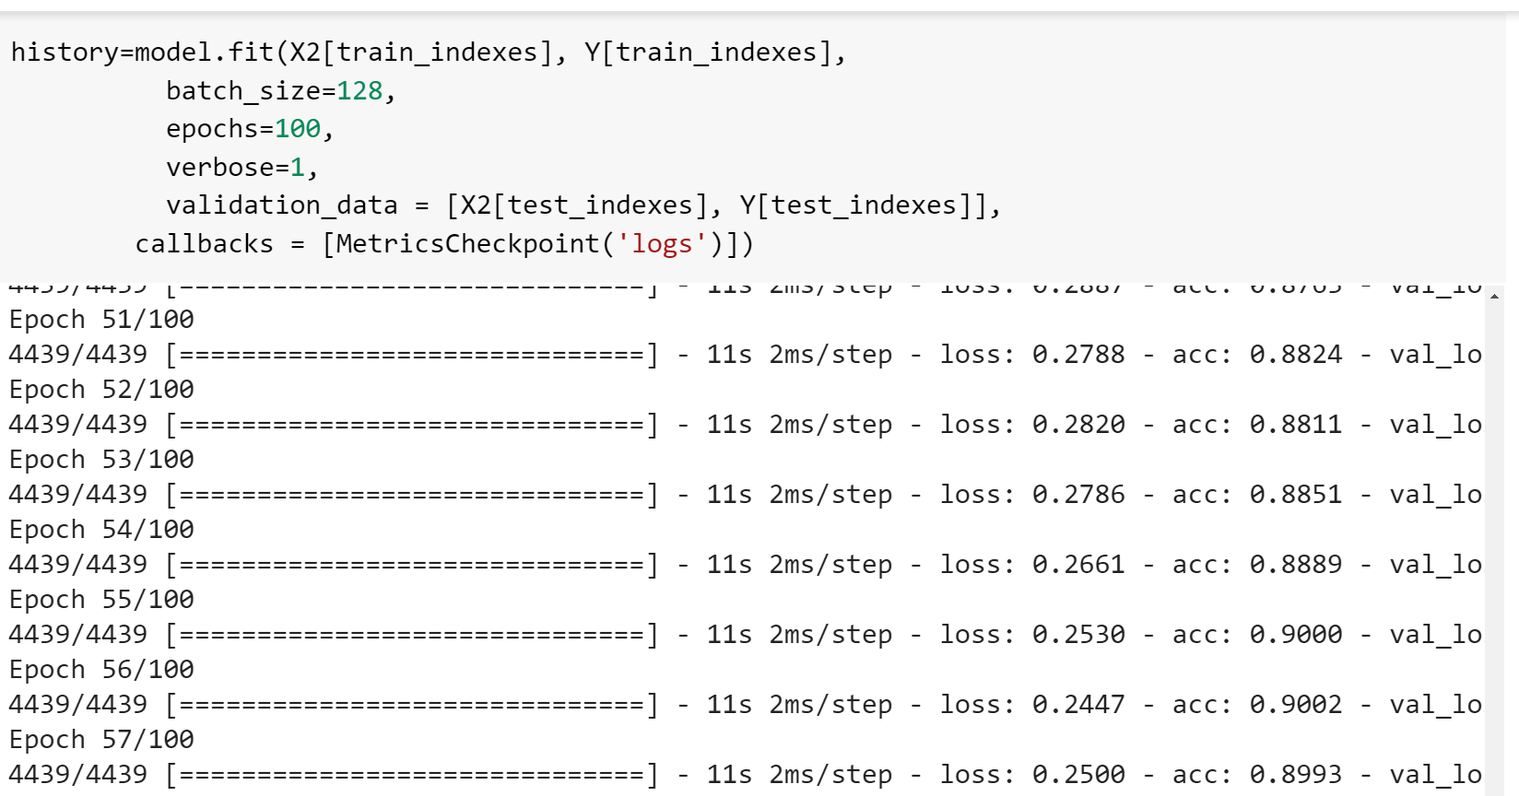
TRAINIG THE MODEL
MODEL HAS BEEN GUIDED TO CONFIGURE THE DATABASE

Slide 12
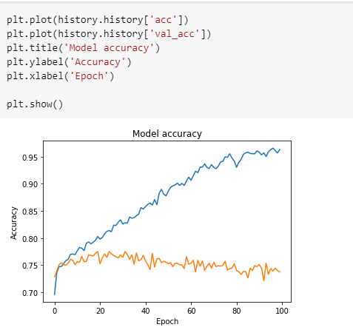
TRACING THE ACCURACY CURVE

Slide 13
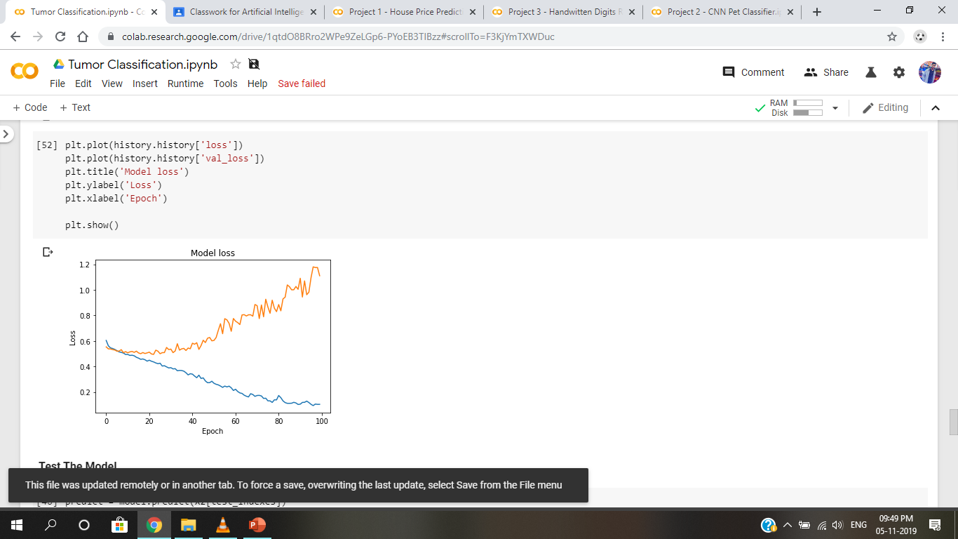
TRACING THE LOSS CURVE

Slide 14
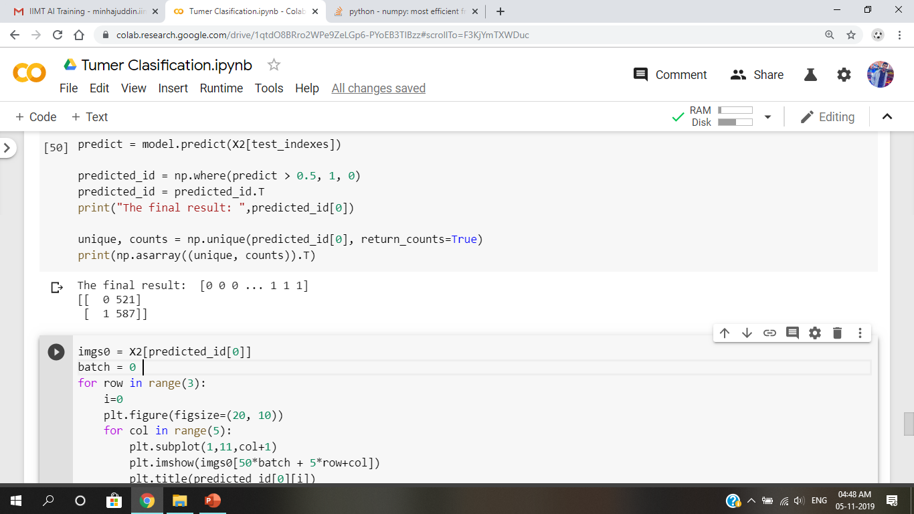
TESTING THE MODEL
MODEL HAS BEEN TESTED FOR FINAL RESULT
TESTING STATEMET

Slide 15
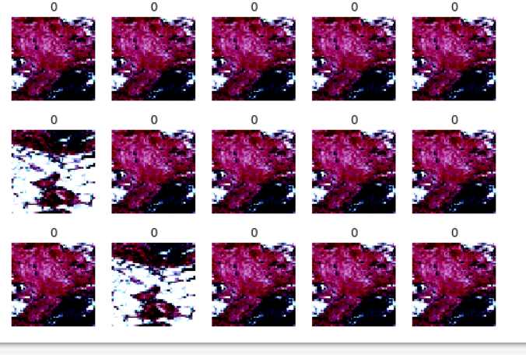
RESULT

